Slide 1
Cisco Discovery Protocol (CDP)

Slide 2
Cisco Discovery Protocol (CDP)
» Cisco proprietary
» Layer 2 protocol for neighbor discovery
» Provides information of platform, interface, IP address, and OS version
» Helps with preparing network diagram

Slide 3
Configuration
» Enabling CDP
• Router(config)# cdp run
• Router(config)# cdp timer <seconds>
» Disabling CDP
• Router(config)# no cdp run
• Router(config-if)#no cdp enable

Slide 4
Verifying CDP
» Verification commands
• Router# show cdp neighbor
• Router# show cdp neighbor < interface>
• Router# show cdp neighbor <interface> detail

Slide 5
Link Layer Discovery Protocol (LLDP)
» Open standard protocol, equivalent to CDP
» Defined in IEEE 802.1ab.
» Limited to only 802.1 media types (i.e. Ethernet…but not WAN interfaces)
» CDP and LLDP can be operational on same interface.

Slide 6
LLDP Configuration
Device(config)# lldp run
Device(config)# lldp holdtime 150
Device(config)# lldp timer 15
Device2(config)# interface ethernet 0/0
Device2(config-if)# lldp transmit
Device2(config-if)# end

Slide 7
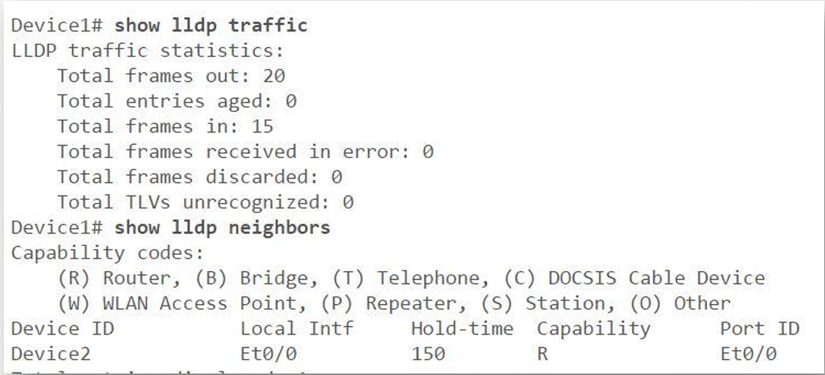
Verifying LLDP

